Slide 1
1. Non-verbal Communication: An Introduction 2. Barriers to Communication
Course Material for B. Tech. (Production) (Sem-VI)
Humanities & Management Dept., VJTI

Slide 2
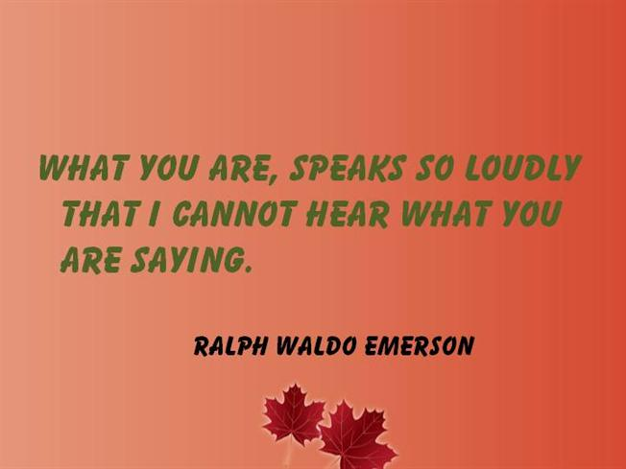

Slide 3
Characteristics of Non-verbal Communication
Conveying idea, etc.
without use of words (written/spoken),
with body language (gestures, postures, facial expressions, eye contact, appearance),
with silence, space (physical proximity), time (for response), surroundings (design of),
with sign language, visual & audio elements, tone of voice.
…is spontaneous / unplanned / unconscious.
…is subtle and instructive.

Slide 4
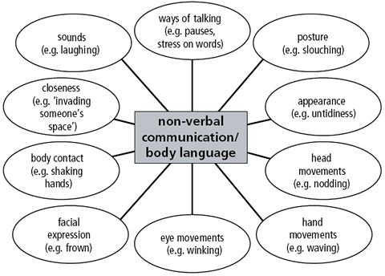

Slide 5
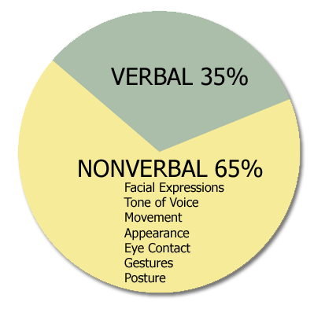
Extent of Non-verbal Communication - The Spoken Part -

Slide 6
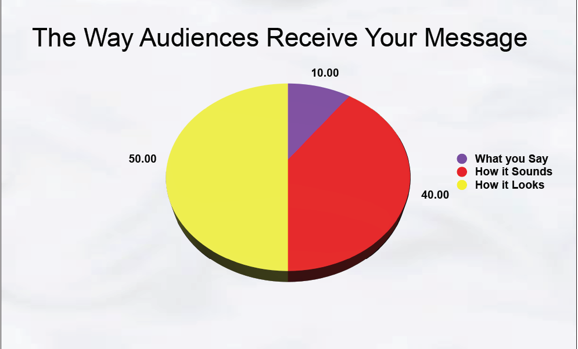
- The Listening Part -

Slide 7

- Gestures –

Slide 8
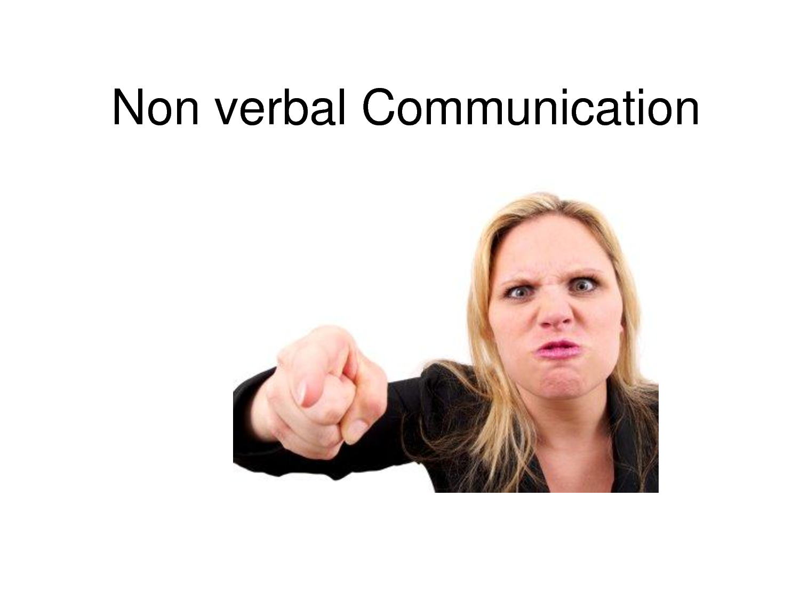

Slide 9


Slide 10
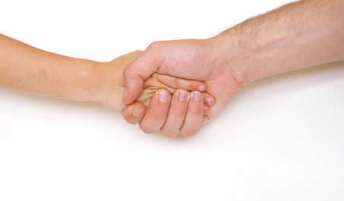

Slide 11
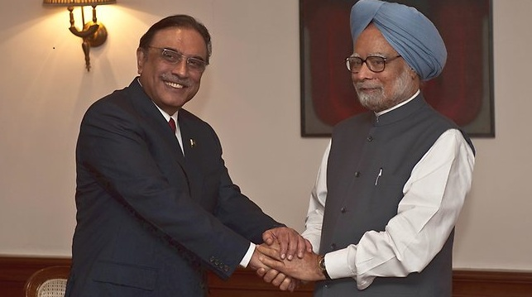

Slide 12
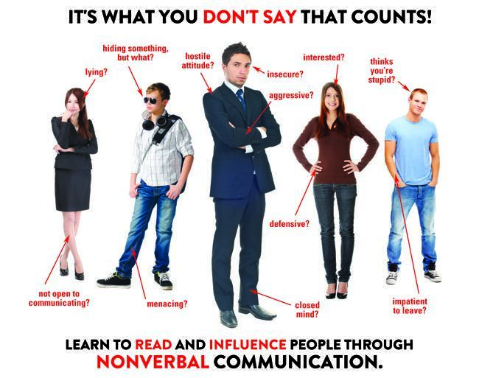
- Postures -

Slide 13
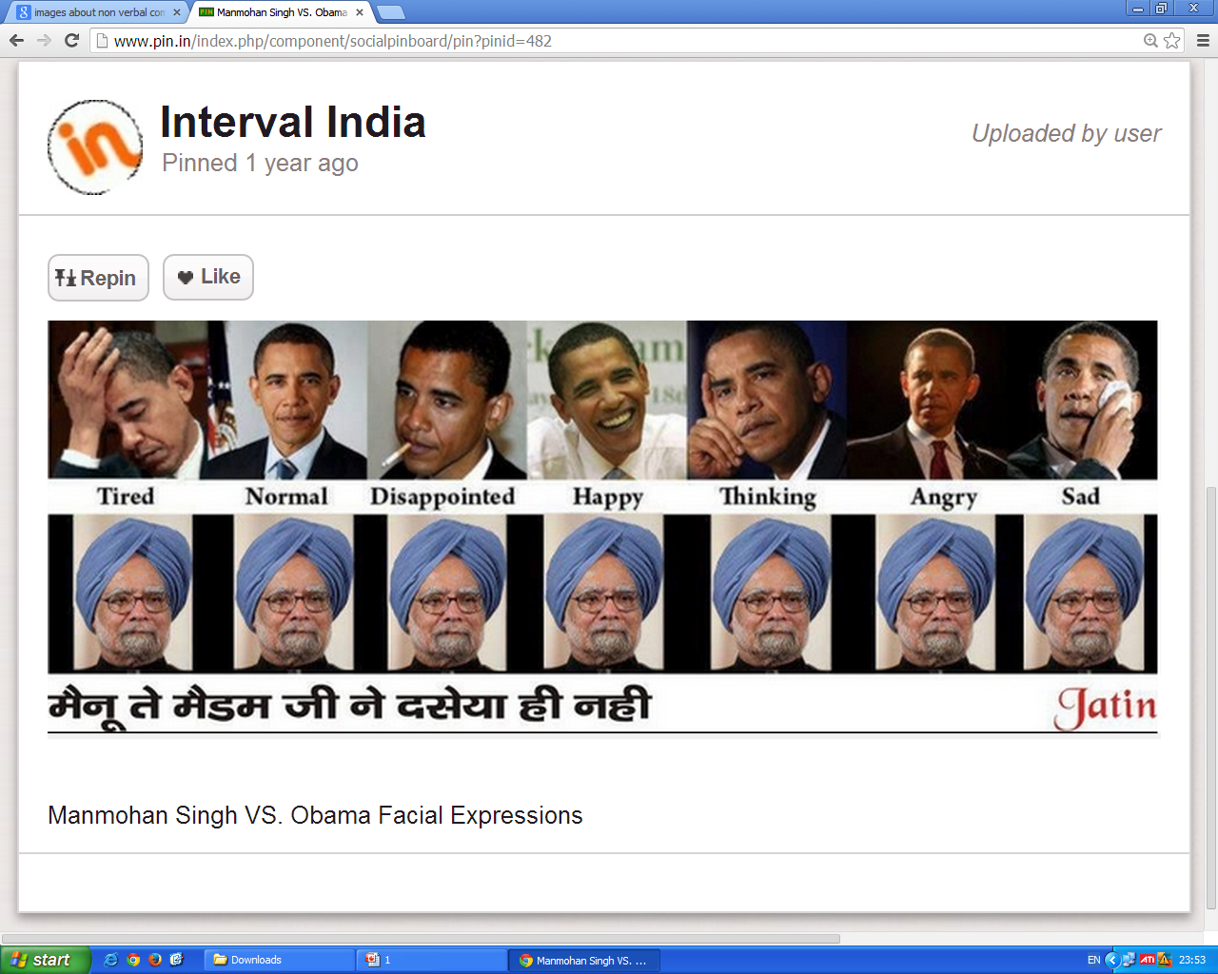
- Facial Expressions Conveying State of Mind -

Slide 14
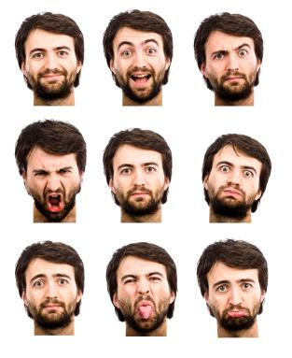

Slide 15
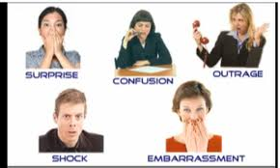

Slide 16
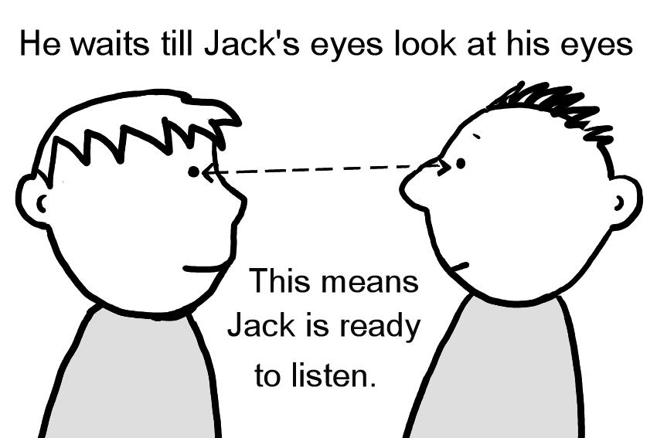
Eye Contact –

Slide 17
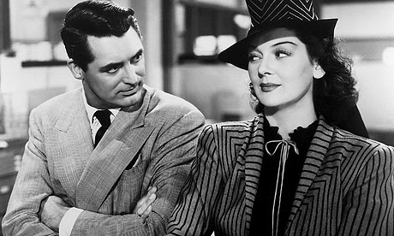

Slide 18
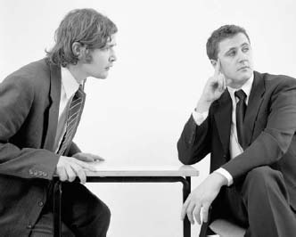
Not making eye contact – shows little interest in the conversation

Slide 19
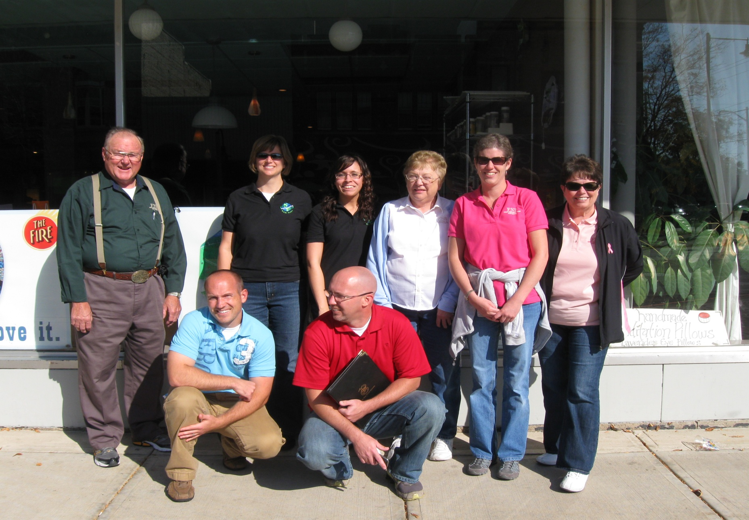
- Space (Physical Proximity) -

Slide 20
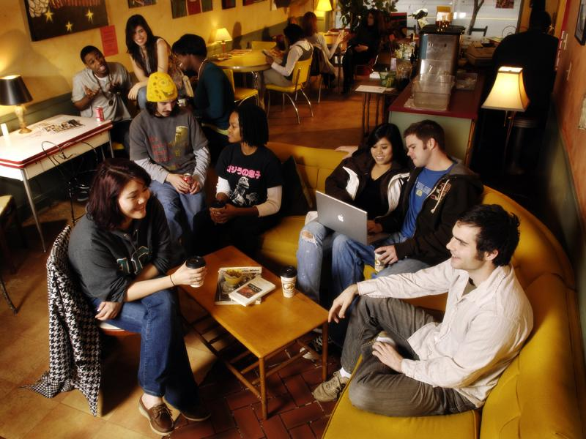

Slide 21
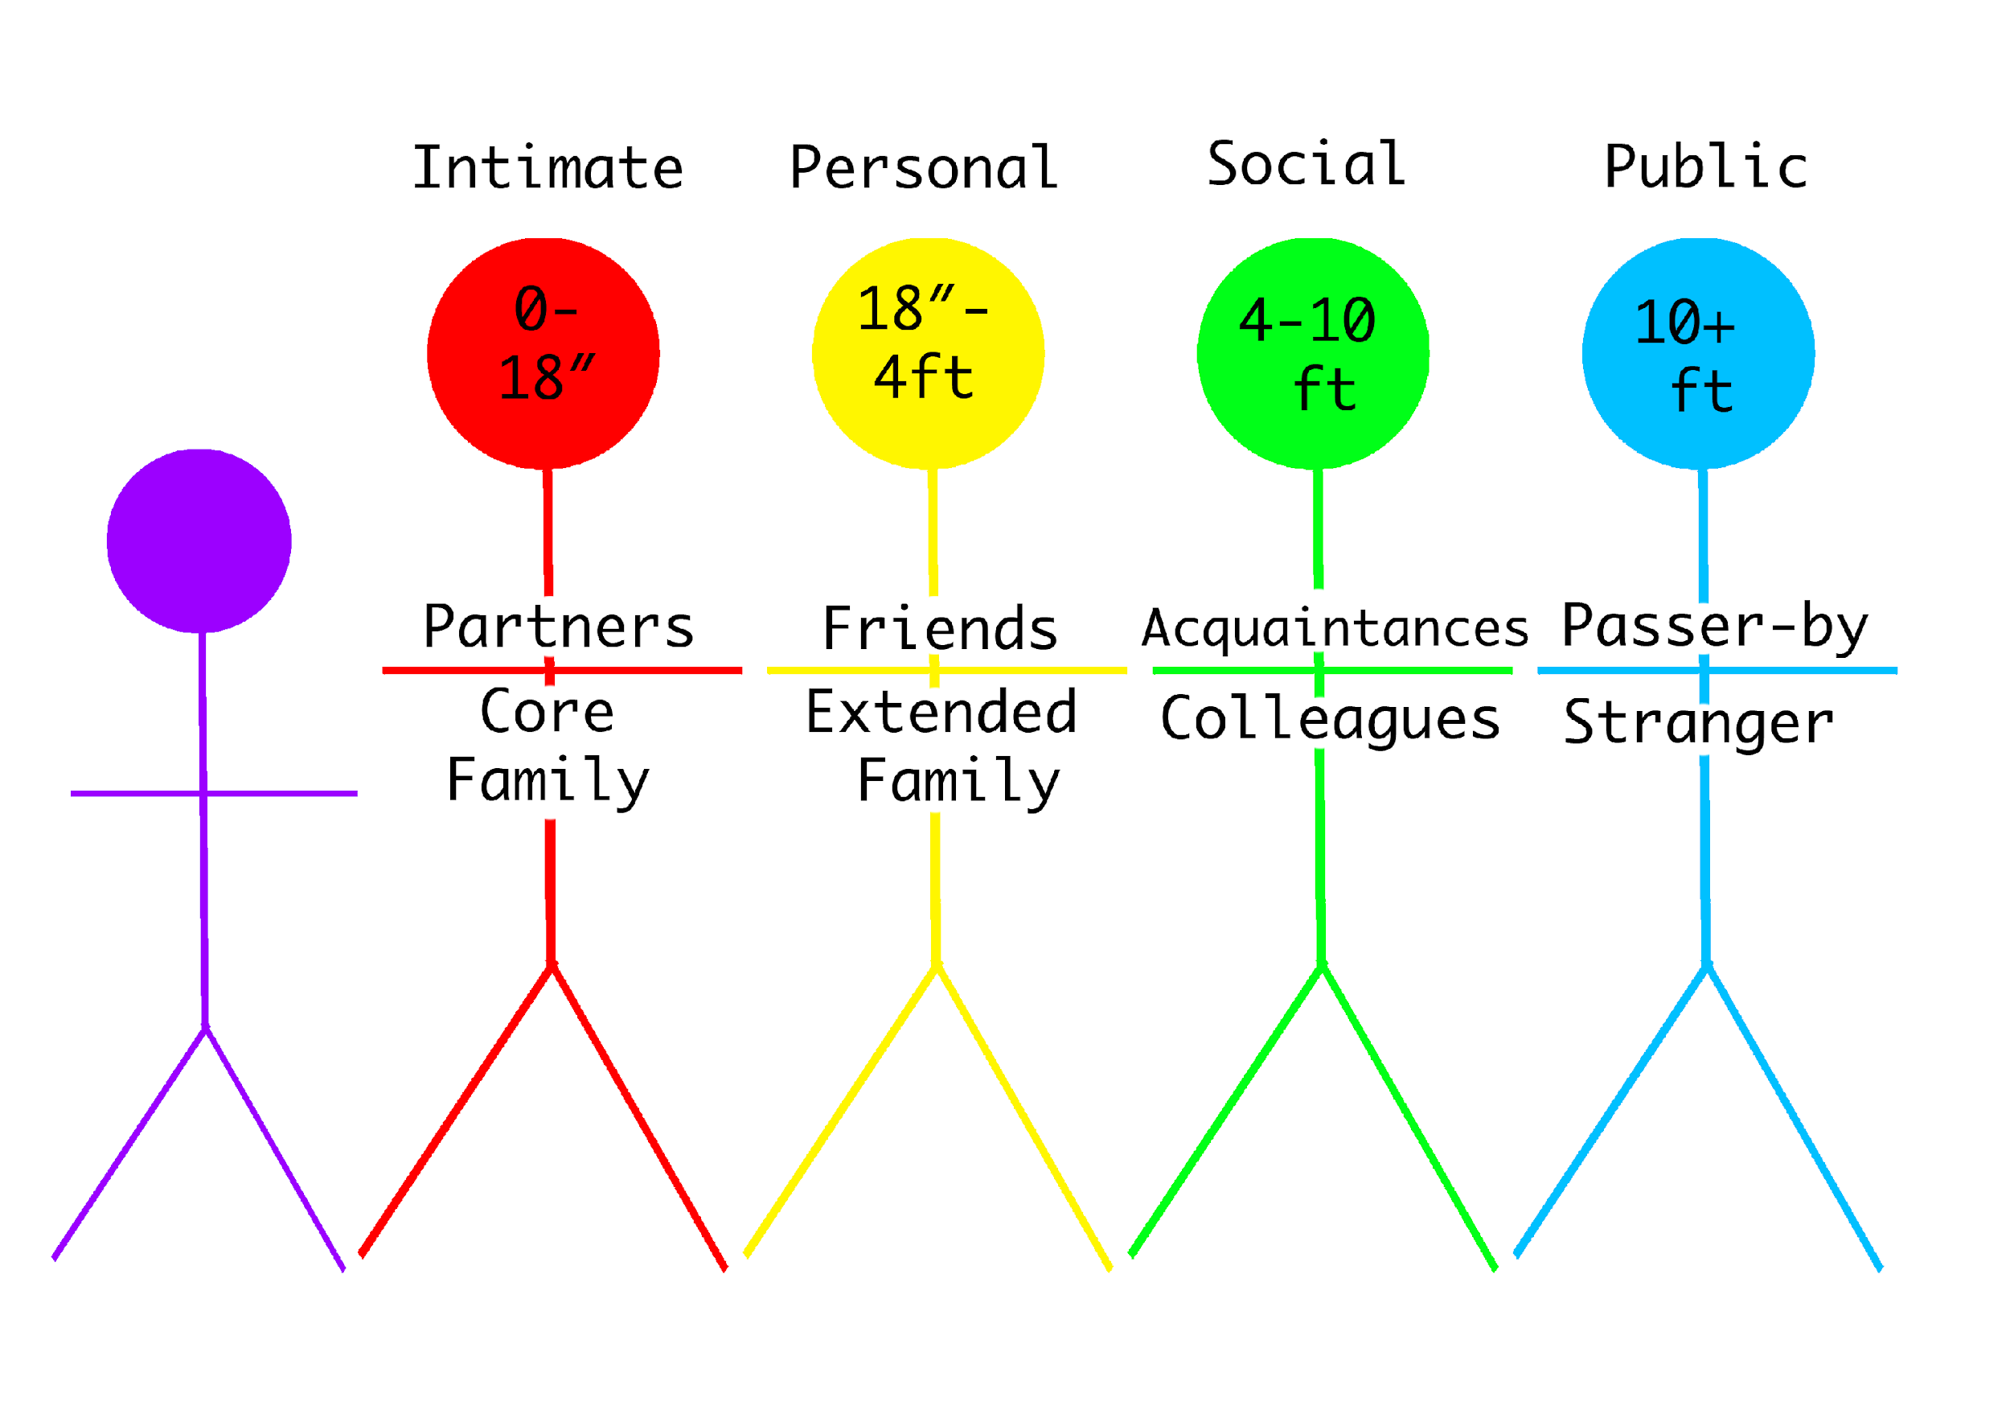

Slide 22
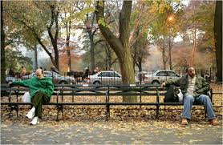

Slide 23
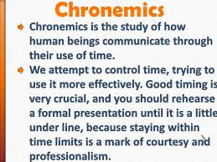

Slide 24

-Surroundings(the way they are designed)-

Slide 25
Barriers to Effective Communication
Language Barriers:
Lack of Common Language
Semantic Barrier
Poor vocabulary, grammar & punctuation
Roundabout verbiage
Physical Barriers:
Noise
Time
Distance
Age
Sex
Social-psychological Barriers:
Status Barrier,
Attitudes & Values,
Different perception of Reality,
Closed-mindedness,
Bad listening,
Emotions,
Resistance to Change

Slide 26

- Semantic Barrier -

Slide 27
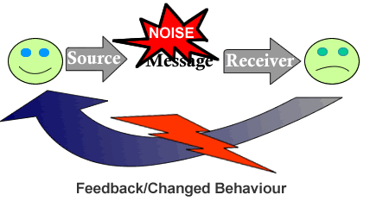
- Noise (as a physical barrier) -

Slide 28

- Psychological Barrier -

Slide 29
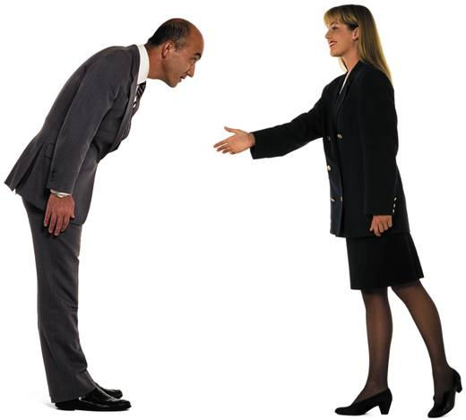
- Cultural Barrier -

Slide 30
Thank You
for a patient & engaged listening!

